Slide 1

SUBSTATION FUNDAMENTALS
SUBSTATIONS
PART 6 Secondary Systems
Module 1
Substation Fundamentals, Finn 2020
Notes:
* Edit the middle of the slide text to add the name of the tutorial organizer as appropriate.
** Edit the middle of the slide text to add the logo of the tutorial organizer as appropriate.
*** Edit the bottom of the slide text to add the presenter, location and date of the presentation.

Slide 2
Part 6 – Outline
Module 1
Introduction
Auxiliary Systems
Protection
Metering and Monitoring

Slide 3
Part 6 – Outline
Module 2
Manual and Automatic Control
Communications
Digital Equipment
Physical Security
Cyber Security

Slide 4
Introduction
What are Secondary Systems
  Substations consist of switchgear (circuit breakers, isolators, earth switches) transformers, reactors, etc. located at a node point in the electricity supply network.
  However without the secondary systems the substation would just be a warehouse for storing these large items of primary plant.
  The secondary systems are the essential ingredients which bring the substation to life enabling the operation, control, protection, monitoring and metering for the substation and the whole power system.
  The secondary systems consist of:-
  Auxiliary Systems
  Protection
  Metering and Monitoring
  Manual and Automatic Control
  Communications
Notes:
No specific notes.

Slide 5
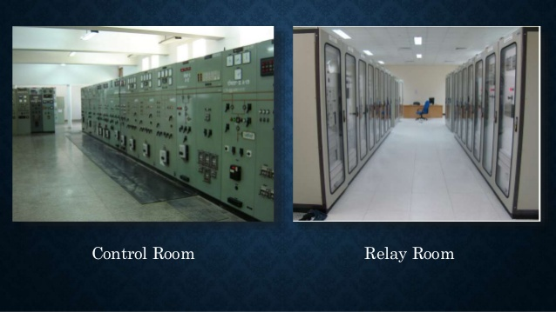
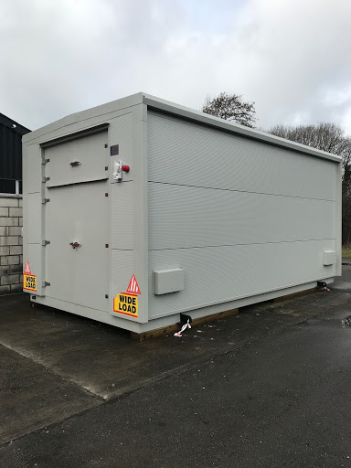
Introduction
Environmental Requirements
The environmental conditions can affect the performance and life of the secondary equipment. Control/relay rooms usually fall into one of the following categories.
Air conditioned – When required the system may have two different temperature settings one for unmanned and one for when work is being carried out.
Heated and/or cooled – this would normally apply to centralised rooms located in Control buildings.
Sheltered locations – this would normally apply to blockhouses and portable relay rooms. The minimum temperature is similar to outdoors but the highest temperature would be higher because of solar heating.
In addition to temperature, filters may be required in dusty or salty environments.
Notes:
The pictures show a typical relay room and control room and a portable relay room.

Slide 6
Introduction
Environmental Requirements
The equipment provided should be suitable for the environment where it will be located. If the room is to be air conditioned then the temperature range required will be much smaller than for relays to be located in blockhouses. Many relays are available for operation over a temperature range of -5degC to +60degC.
It is quite usual to provide anticondensation heating in panels. This is required where the humidity is high to prevent condensation from forming on any metal parts as the temperature cools down. The heaters are usually operated with a thermostat.
As the temperature inside the panel will be higher than outside because of the heat dissipated by the relays then it may on some occasions be necessary to provide cooling. If cooling is essential for the safe and correct operation of the equipment then it ideally should be fed from the DC supply for security and redundant coolers may be required.
Notes:
No specific notes.

Slide 7
Introduction
Operation and Maintenance Requirements
The important operational and maintenance requirements are listed below:
Safety of personnel and security of operational functions.
Speed, selectivity and sensitivity of operation (e.g. protection equipment).
Reliability/availability.
Meet environmental conditions.
Long life time.
Easy to isolate
Easy to maintain.
Easy to repair.
Easy to get spare parts (over the life time of the system).
Easy to extend (over the life time of the system).
Easy on-site testing.
The older conventional secondary equipment generally met all of these requirements. Modern electronic equipment has a shorter life but has higher flexibility and the possibility of achieving more intelligent decisions. Self supervision leads to less periodic testing and maintenance and defective components (cards) can easily be changed by the maintenance staff.
Notes:
No specific notes.

Slide 8
Introduction
Economic Considerations
The basic economic considerations are the initial investment costs including design, equipment, installation and commissioning costs, cost of operation, maintenance, cost of post delivery support and repair, cost of personnel training and cost of extending the system at a later date.
These all benefit from developing a standard configuration with detailed specifications.
The biggest economic challenge with modern secondary systems is the shorter lifespan being only 10/15 years compared to the 30/40 years achieved by conventional systems.
This need to replace the systems after 10/15 years has a significant cost implication as well as the added difficulty of achieving the required outages to carry this out.
Notes:
No specific notes.

Slide 9
Introduction
Ergonomic Requirements
In the past mimic diagrams provided good comprehensibility. However, with digital systems visual displays are used even in the case of large and complex substations.
A balance has to be struck between limiting the information presented on the visual display, to maintain reasonable legibility, (typically dictating that the degree of filling of the screen should not exceed about 6%) and minimising the number of process displays.
It is important that the arrangement and design of the system has to be adapted to match human capabilities:-
Information on displays or screen must be easily visible (readability) and logically classified (shape, colour).
Screens, displays and/or operation panels must be arranged properly for the operator to allow easy operation.
Rapid system response after operator action is necessary.
Ambience (light, temperature, humidity) should be comfortable.
Notes:
No specific notes.

Slide 10
Introduction
Electromagnetic Compatibility (EMC)
Electromagnetic interference due to different noise sources in AIS and GIS substations may cause maloperation or even damage to the equipment.
The problem of EMC can be considered in three parts:
To define the level of transient overvoltage at the terminations of secondary equipment.
To define the withstand capability of the secondary equipment and provide recommendations for test requirements.
To give recommendations for the complete layout of secondary circuits including the earthing system in order to reduce the influence of transient overvoltages on secondary equipment.
It is common practice to divide substation secondary equipment into several classifications according to the amplitude of the interference signals to be expected, severe categories, for equipment situated close to the switchgear and low level classes where situated distant from the HV-equipment, except for GIS where it is all considered close.
Notes:
No specific notes.

Slide 11
Introduction
Methods to minimize the effects of EMC
The following measures are recommended to minimise the effects of electromagnetic interference.
Exclusive adoption of screened secondary cables, if necessary with special screen construction; generally it is advantageous to earth the screen at both ends.
Earthing conductors that are laid in parallel to cables in trenches to reduce screen current and to couple inductively the secondary system and the earthing system.
Adequate design and test of secondary equipment in relation to amplitude, frequency and energy content of interference stresses.
  Specifically for GIS substations
  Connection of reinforcement steel to the earthing system at various points but avoiding loops, especially in the floor.
  Good screening at the GIS/air bushings by multiple connections between enclosure and wall (reinforcement, metallic wall) and additionally multiple connections between wall and earthing grid at ground level.
  Galvanic connections between HV cable screens and GIS enclosure, if only single point earthing for the screens is allowed leave one end not connected.
Notes:
No specific notes.

Slide 12
Auxiliary Systems
Introduction
These consist of the low voltage AC and DC power supplies required to power all of the substation auxiliaries.
The LVAC supplies provide power for
Battery chargers.
Transformer fans and pumps.
CB and DS/ES mechanisms if AC is used.
Air conditioning.
Heating (including anti condensation heating for breaker tank and cabinet heaters).
Lighting.
Sockets and receptacles.
Notes:
No specific notes.

Slide 13
Auxiliary Systems
Whilst the DC supplies derived by rectification are used for
Control and protection of the plant.
Tripping of the circuit breakers to clear faults and closing/opening of CBs, DSs and ESs if DC used.
Supplies to relays.
SCADA.
Communication systems.
Emergency Lighting.
The auxiliary systems need careful design to ensure reliable operation of the substation.
Both the AC and DC auxiliary systems should be designed to meet the immediate demand and likely future extension.
Notes:
No specific notes.

Slide 14
Auxiliary Systems
LVAC System
Performance Requirements and Design Considerations
Performance Requirements (typical for Europe)
Typically 400/230 Volt with tolerance +/- 10%.
Frequency +/-1%.
Insulation level normally 1kV.
Short Time Rating – 20-50kA for 1 second.
Power kW/kVA rating must meet all site demands.
Design Considerations
System rating must meet all site loads.
Allowance to be made for future extension of substation at least 10%.
Board often split into essential and non-essential loads.
Essential loads usually supported by standby emergency diesel generator.
Automation may be applied between the main incoming sources of supply.
Compliance with local wiring regulations.
Notes:
These figures are typical for Europe. The design considerations will be similar worldwide but the figures under performance requirements will be tailored to suit the local conditions.

Slide 15
Auxiliary Systems
LVAC System
Possible Sources of LVAC supply
Substation auxiliary supplies are often obtained from the following sources:-
On-site earthing/auxiliary transformers – permanent supply.
An adjacent generating station – permanent supply.
A local Distribution Network Operator (DNO) – permanent supply.
On-site diesel generating set/s – standby supply.
A facility to readily connect a fully rated mobile diesel generator – standby supply.
The LVAC system will usually have three sources of input which may be two permanent sources and one standby source or one permanent source and two standby sources.
Notes:
A standby supply such as a diesel generator will be needed in case of total blackout of the substation and surrounding area.

Slide 16
Auxiliary Systems
LVAC System
Possible Sources of LVAC supply
Earthing/auxiliary transformers - Tertiary connected to a supergrid transformer.
  The voltage variation from a tertiary winding may exceed the tolerance limits required for the LVAC system so it is normal to install a voltage stabiliser between the earthing/auxiliary transformer and the LVAC board. This will add cost and complexity to the supply system.
  If the SGT is out of service then the incomer to the LVAC is also out of service.
  There is no long term cost to a third party (DNO).
Earthing/auxiliary transformers - Phase connected to a supergrid transformer.
The voltage variation on the phase conductors is controlled by the SGT tap-changer so the earthing auxiliary transformer is directly connected without requiring a voltage stabiliser.
If the SGT is out of service then the incomer to the LVAC is also out of service.
There is no long term cost to a third party (DNO).
Notes:
It is quite usual to derive the supplies from an earthing/auxiliary transformer associated with a supergrid transformer but an alternative supply will ne needed for when the supergrid transformer is out of service.

Slide 17
Auxiliary Systems
LVAC System
Possible Sources of LVAC supply
Distribution Network Operator (DNO) supplies
  As these supplies are independent of the substation they are not usually related to the service status of the substation transformers.
  Supply will typically require a stepdown distribution transformer/fuse switch normally located within, or close to, the substation.
  The DNO supply will require tariff metering either at the LVAC board or in the DNO distribution unit. This is a lifetime cost to the substation owner.
Standby Generator Supply
There are two main options for standby generator supplies
An on-site permanently connected diesel generator, usually with automatic start up on failure of the permanent supply/s.
A connection point (usually plug and socket) for connection of a mobile generator.
Notes:
It should be noted that although the DNO supply is not taken from any specific equipment in the substation it is quite possible that if the transmission substation is dead then the local distribution network may also be dead. A standby diesel generator is always recommended.

Slide 18
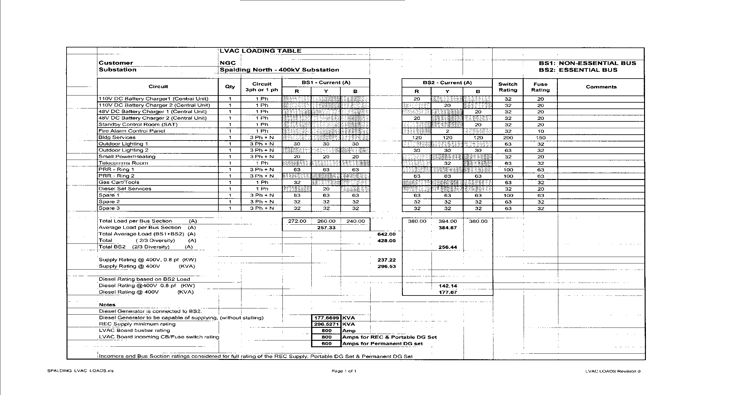
Auxiliary Systems
LVAC System
Load Table and Diversity
The table below is for a typical LVAC board. It collects all of the loads for both essential and non-essential bars, applies diversity typically 2/3rds and assumed pf of 0.8.
From the table the current on both the essential and non essential bars can be extracted. Using the pf of 0.8 the kW and kVA are then derived. This enables the size of the required auxiliary transformer to be decided and also from the essential bar the size of the standby generator can also be defined.
Notes:
No specific notes.

Slide 19
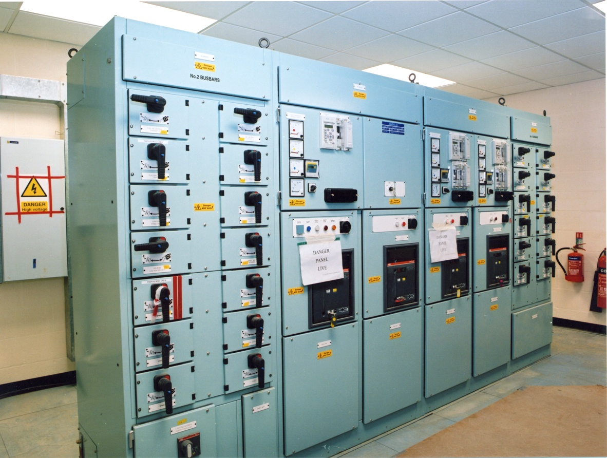
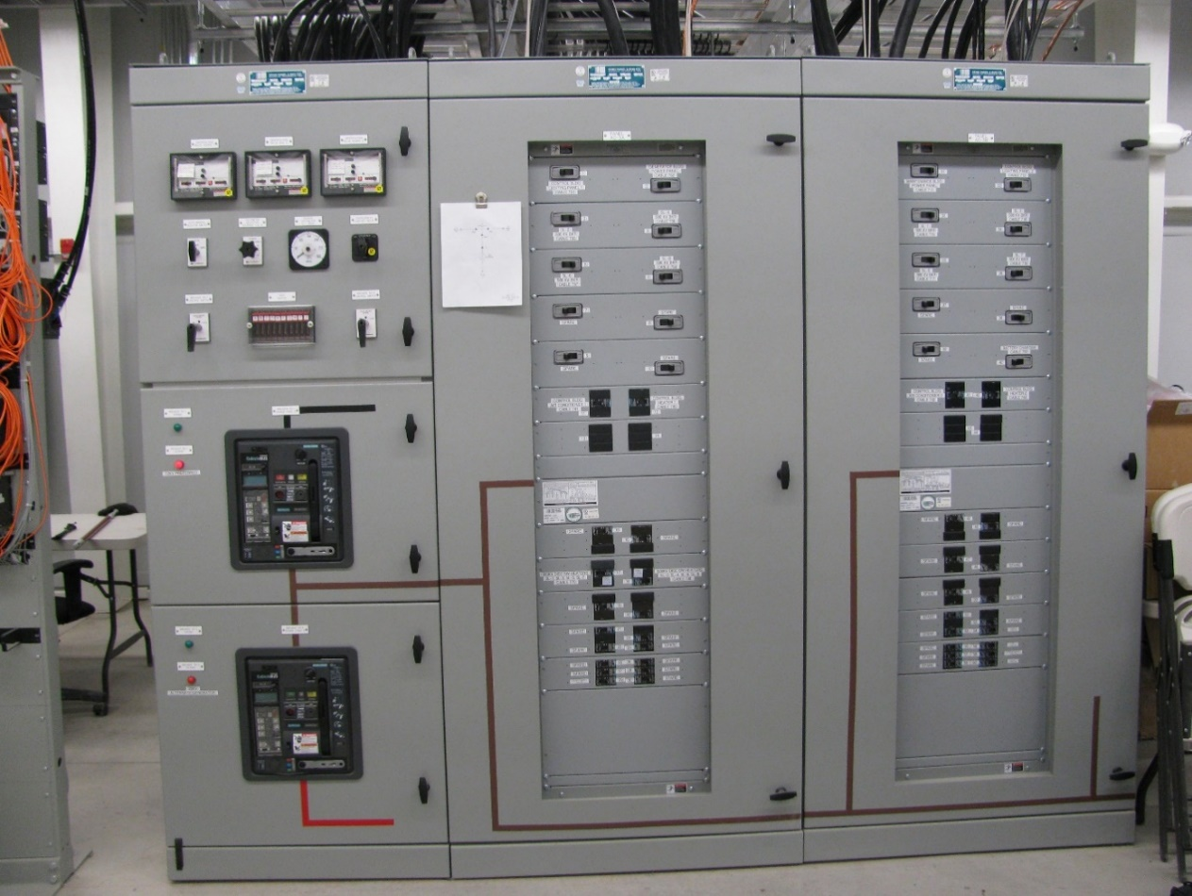
Auxiliary Systems
LVAC System
Typical LVAC Board Layout
Modern LVAC board
120/208V 1600A 3Ø AC Switchboard
for 500/138kV EHV Substation in USA
Notes:
The pictures show typical LVAC boards in the UK and USA.

Slide 20
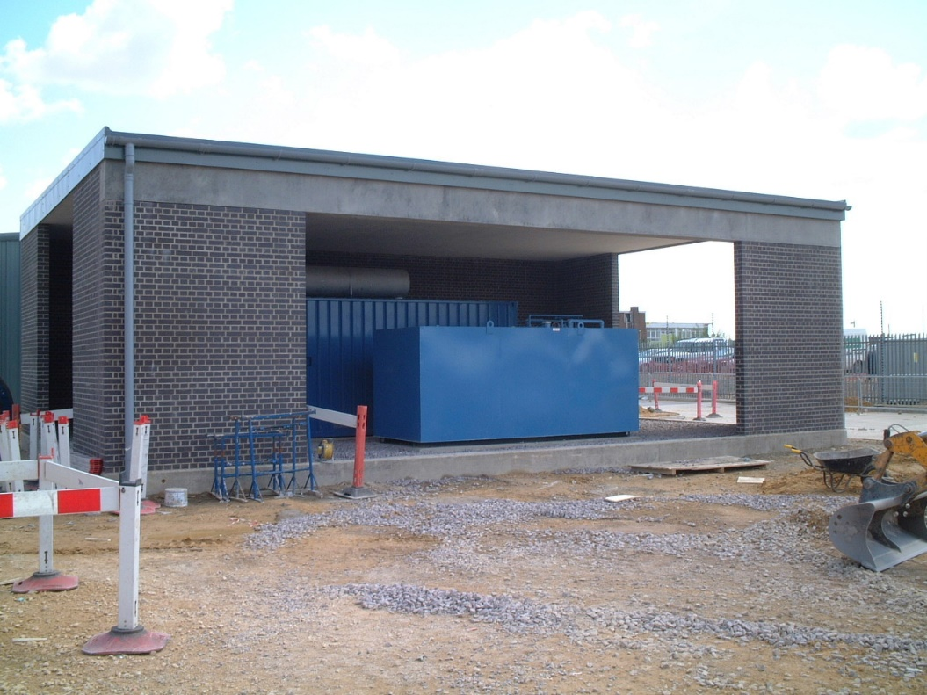
Auxiliary Systems
LVAC System
Need for a Backup Generator
The operational security of substations is very important and this depends upon the availability of auxiliary supplies.
The auxiliary supplies are usually derived from the substation itself or the local DNO supplies.
In the case of a serious incident at the substation both of these sources of supply may be lost at the same time.
In such a case a standby generator, usually diesel powered but maybe gas fired is employed.
The standby generator will usually be arranged for automatic start in the event of the loss of the permanent supplies.
However care needs to be taken to ensure that the standby generator does not run in parallel with the permanent supplies.
Notes:
No specific notes.

Slide 21
Auxiliary Systems
LVAC System
Performance Requirements for Backup Generator
The following requirements are typical for a standby generator in Europe.
400/230 Volt, 3 phase & neutral, 50 or 60Hz, power rating (kW @ 0.8pf)
Power Rating must be capable of supplying the essential site loads
Must be capable of handling the application of large block loads without stalling.
Normally the generator will only be capable of starting against 60% of rated load so this may require oversizing the generator or applying a load sequencing programme.
Automatic starting from loss of normal supplies.
Manual starting and stopping for test purposes by site personnel.
Protected against overspeed.
Fitted with a “day-tank” and may have additional fuel tanks for longer running if required.
Suitable for ambient conditions (typically -10degC for indoor and -25degC for outdoor).
Provisions to be made to prevent freezing of the fuel and the coolant.
Notes:
No specific notes.

Slide 22
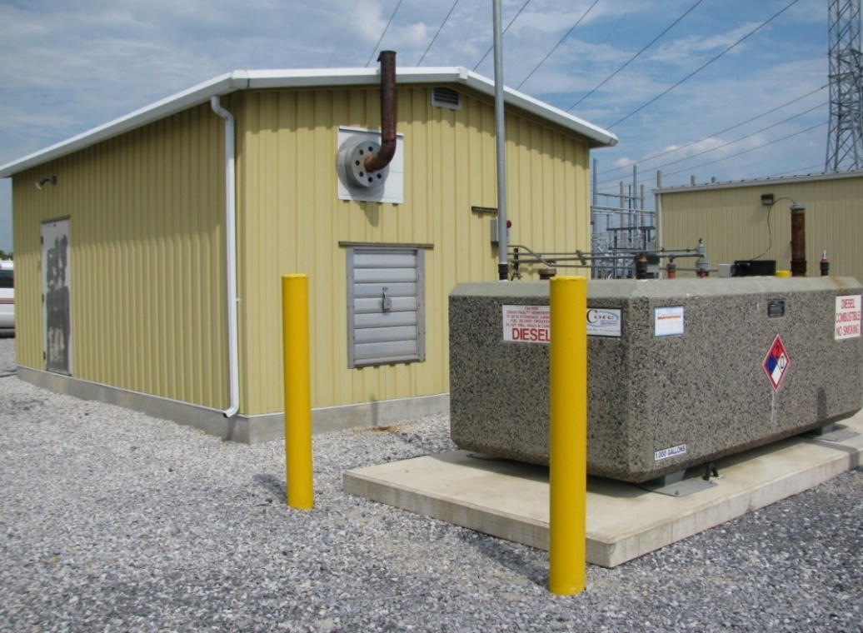
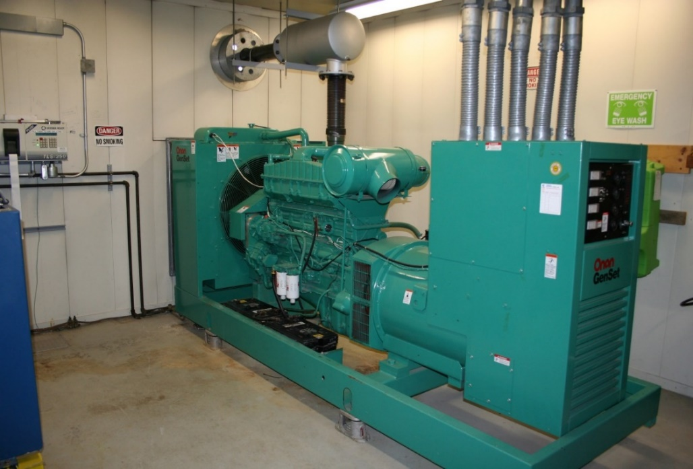
Auxiliary Systems
LVAC System
  Example: Emergency Station Service AC Supply from diesel generator in the USA
  Outdoor 1,000 gallon (3785litre) above-ground diesel fuel main tank and indoor 300 gallon (1135litre) day tank
  Enclosed 600 hp (447kW) engine with 500 kVA 208 V generator
  Automatic transfer switch to connect stand-by power supply during loss of main supply
  (not visible in photos)
  Used for stand-by power supply for 500-138 kV EHV substation in the event of loss of main supply
Notes:
As most of the examples are from Europe then this slide was introduced to show the similar arrangements in the USA.

Slide 23
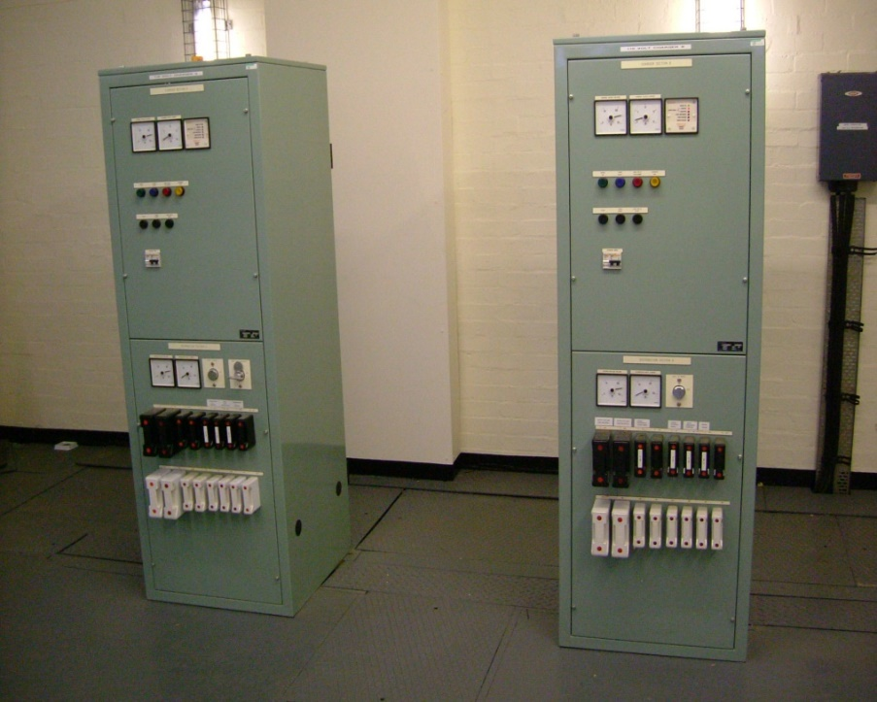
Auxiliary Systems
Battery and DC System
Basic DC System explanation
The DC system provides a secure supply for the control, protection, monitoring, metering and communications for the plant. The DC system consists of:-
A battery charger.
The battery charger is fed from the LVAC supply. It rectifies this to DC which is filtered to remove AC ripple. The output is used to feed the normal continuous DC loads. It also trickle charges the battery during normal operation or can boost charge the battery if required.
Notes:
Under normal running conditions the DC supply is derived from the charger and the battery acts as a load on the charger. If the charger or supply to the charger fails then the battery will immediately pick up the duty of supplying the DC.

Slide 24
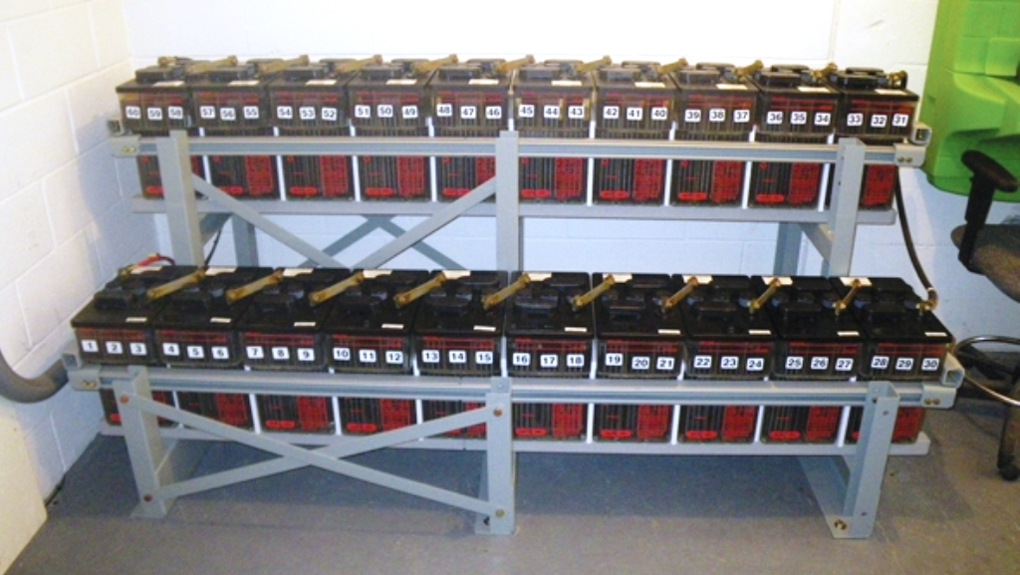
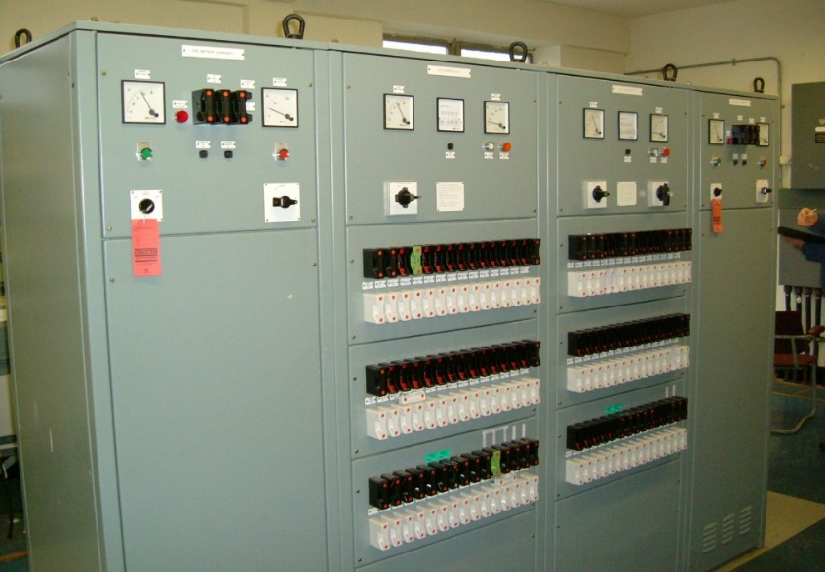
Auxiliary Systems
Battery and DC System
Basic DC System explanation
A battery.
The battery provides peaking capability as well as being the back up in the event of loss of AC supply to, or failure of, the charger.
A DC Distribution board.
The DC distribution board feeds all of the DC loads as well as receiving the inputs from the battery/charger combinations. It will normally have automation in the event of failure of an input.
Notes:
The upper picture shows a centralized battery in a battery room. The lower picture a typical DC distribution board in the UK. The sizes of the fuses and links are typical of UK overdesign.

Slide 25
Auxiliary Systems
Battery and DC System
Typical Battery Voltages
Batteries used for communication purposes are typically 24V, 30V, 48V or 60V.
Those used for protection and tripping are usually 110V, 125V or 220V.
The cell voltages for lead acid cells are 2V and for Ni-Cd are 1.2V.
Under normal operating conditions the battery will be in trickle charge condition so that the voltage of the DC system will be 10-12% higher than the battery voltage so that a 110V battery system may be normally operating at about 124V and this should not be confused with a 125V battery system.
When the charger is switched off the DC voltage on the system will fall to the battery voltage so from 124V to 110V.
As the battery discharges into the load the battery voltage will decrease until at the end of the standby period it will be down to the defined minimum voltage.
Notes:
No specific notes.

Slide 26
Auxiliary Systems
Battery and DC System
How to determine the standby period for batteries
The battery only needs to deliver power when the LVAC supply is lost. The longer that the battery needs to supply the DC system the larger and more expensive the battery.
Upon loss of the permanent LVAC supply a standby generator will probably have automatically started to restore the supply. The operators will have become aware of problems arising with the supplies at the substation. If the diesel generator has not cut in or has run out of fuel then the LVAC supply will be lost and it will become necessary to have the DC system fed from the battery.
The battery must be able to supply the DC system for long enough for the repair team to get to the substation and rectify the supplies problem.
This time will depend upon the location of the substation relative to the maintenance teams.
For reasonably densely populated countries or areas a time of about six hours is often sufficient.
For very remote areas, or possibly offshore, longer standby periods may be required.
Notes:
No specific notes.

Slide 27
Auxiliary Systems
Battery and DC System
Types of Battery
The most common types of battery used in substations are lead acid and nickel cadmium.
A comparison of the features of both is shown in the adjacent table.
Lead acid are initially cheaper, shorter life, need more maintenance and are not suitable for use in very high or very low temperatures.
Lead acid are also less reliable because of sudden catastrophic failure.
* VRLA – valve regulated lead acid
Notes:
In summary, whilst lead acid batteries are cheaper, they do not last as long and are not as reliable as Ni-Cd. The latter type are necessary if the batteries are to perform in very high or very low temperatures.

Slide 28
Auxiliary Systems
Battery and DC System
Battery Specification Considerations
The following parameters are important to obtain the correct battery:-
The voltage of the battery.
Type of battery lead acid or Ni-Cd.
The ambient temperature.
The length of the standby period and the voltage at the end of the standby period.
Normally the capacity of the battery is defined in Ah.
This capacity is usually associated with a defined discharge current so say 240Ah with discharge current of 40A. This means that the battery will discharge to the defined voltage in 6 hours. If the battery discharges at a different current then the capacity in Ah will be different.
In substations there is usually a low standing current on the battery and a number of much higher currents for a short time, such as starting and running current of motors and trip currents of CBs under bus zone trip conditions.
For this reason it is strongly recommended that the battery supplier is supplied with a load profile graph.
Notes:
No specific notes.

Slide 29
Auxiliary Systems
Battery and DC System
Example of Load profile
Notes:
This shows a typical load profile graph with a low standing load and a number of high loads at the end of the standby period.

Slide 30
Auxiliary Systems
Battery and DC System
Battery Earthing Considerations
The battery systems will normally be fitted with a battery earth fault alarm.
For protection and control batteries these often use a centre-point earth system (see diagram).
If an earth fault occurs on either the positive or negative a current will flow through the 6 and 10 kOhm resistors and the detection relay will operate.
Notes:
No specific notes.

Slide 31
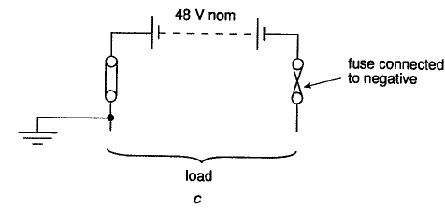
Auxiliary Systems
Battery and DC System
Battery Earthing Considerations
In the past negative biasing was used to reduce corrosion. In this system the positive terminal was biased typically 35 volts negative so that the negative terminal to earth was approximately 160V to earth when the charger is in service.
For communications batteries these are usually earthed solidly on the positive terminal and the fuse is fitted to the negative rather than the positive.
Notes:
No specific notes.

Slide 32
Auxiliary Systems
Battery and DC System
Central or Distributed Batteries
For substations at distribution voltages and also for GIS substations at all voltages it is quite usual that a centralised battery system will be used.
However at higher voltages typically above 145kV the distances between bays within air insulated substations become very great.
This causes a problem with voltage drop in the cabling from the centralized battery system to the remote bays in the substation which may mean that when operating on battery only there may not be sufficient voltage at the trip coils to operate them.
In this case distributed battery systems with batteries located in block houses adjacent to the bay may be employed using valve regulated lead acid (VRLA) sealed batteries.
Notes:
No specific notes.

Slide 33
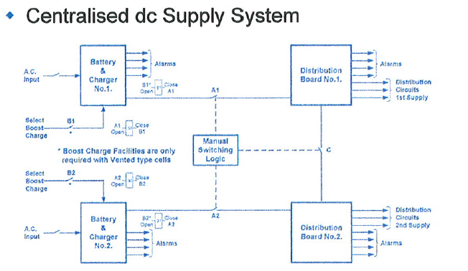
Auxiliary Systems
Battery and DC System
Duplicated Battery Systems - Central
The battery systems are normally duplicated as shown below:-
Notes:
This shows a typical DC system with two DC supplies 1 and 2. Each battery and charger system is rated to be able to supply both the No 1 and 2 supplies but they are normally run separated from each other. If one of the supplies fails then the two systems can be coupled and fed from the healthy system.

Slide 34
Auxiliary Systems
Battery and DC System
Duplicated Battery Systems - Distributed
When the batteries are distributed the duplicate systems are usually derived from two adjacent relay rooms
Notes:
With this system each battery system is sized to cover two circuits. Normally the battery system in one relay room will supply the No.1 system for its own circuit and the No.2 system for the adjacent circuit. If one system fails the standby supply links can be closed to feed both systems for both circuits from the healthy system.

Slide 35
Auxiliary Systems
Battery and DC System
DC Cabling
The size of the cable cores will to some extent be defined by the current which the wire has to carry. However usually either 1.5mm² or 2.5mm² will be sufficient.
However, for some functions the size of the cable cores is decided not by the current carrying capacity but by the voltage drop within the circuit depending upon the total length of cabling involved.
This is most usually encountered with regard to trip circuits where, under the condition that the DC system is operating on battery only, the voltage at the trip coil at the end of the standby period must be sufficient to operate the tripping. This condition is exacerbated by trip circuit supervision where the cabling loops from contact to contact to ensure that the whole of the trip circuit is supervised. This results in some very long cable lengths in the trip circuit often requiring cable cores of 25mm² or even larger to ensure adequate voltage at the trip coil.
Notes:
No specific notes.

Slide 36
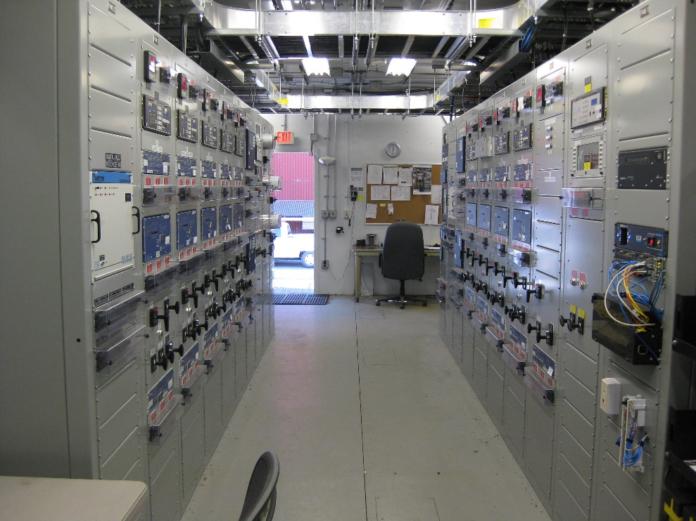
First set of Questions

Slide 37
Protection
Role of Protection
Protection is like an insurance policy. It cannot prevent faults from happening but is there to deal with the consequences of the fault by minimizing damage to the equipment and disruption to the power network.
In order to do this it must be capable of:-
Fault Detection – Detect that a fault is present on the network.
Discrimination - it should select and disconnect the minimum amount of equipment necessary to disconnect the fault, thereby minimising disruption to the wider network.
Speed of operation - Needs to disconnect faulty equipment quickly to ensure safety, minimise damage to plant, both the faulty equipment and adjacent equipment and maintain system stability.
Notes:
No specific notes.

Slide 38
Protection
Short Circuit Fault Detection
There are three main ways of detecting when a short circuit fault occurs on the system. These are:-
Over current – when a fault occurs on the system usually the current in the circuit increases.
Impedance – when a fault occurs the voltage drops and the current increases so the measured impedance reduces.
This is the basic principle of Distance protection.
Differential – normally the current entering a circuit is equal to the current leaving it. (What goes in comes out- Kirchoff’s current law). If this is not the case there is a fault in the circuit.
Notes:
No specific notes.

Slide 39
Protection
Time Graded Overcurrent Protection
Overcurrent is possibly the most widely used and most basic form of protection. An over-current relay will operate for any current flowing through it above its setting value. This means that it has no defined zone of operation and consequently cannot discriminate for faults on other circuits or parts of the network. In order to achieve discrimination we need to add time, current or a combination of time and current to the relay.
Time graded protection i.e. grading by time alone is only really achievable for radial distribution usually at lower voltages. The relays have a number of different time delays which can be set. The further down the radial feed from the source the shorter the time setting which should be chosen.
This means that the relays on circuits nearest to the fault trip first and clear the fault thus minimizing the amount of circuits disconnected.
Notes:
No specific notes.

Slide 40
Protection
Current Graded Overcurrent Protection
Usually an overcurrent relay will have a number of possible current settings which can be chosen.
The current for a particular fault will be limited by the impedance between the source and the point of fault. The higher the impedance the lower the current.
A good example of this is the use of high set overcurrent on a transformer. If the transformer has a 20% impedance on rating then the maximum through fault current will be 5 times full load current. If the instantaneous overcurrent relay is set to 8 times full load current then it will not trip for faults beyond the transformer. i.e. effectively limiting the reach of the relay.
For radial circuits, the further from the source the lower the fault current will be. Thus if the relays furthest from the source are set with the lowest current setting and the current setting is increased as you get nearer to the source this will allow selective tripping of the circuits.
Notes:
No specific notes.

Slide 41
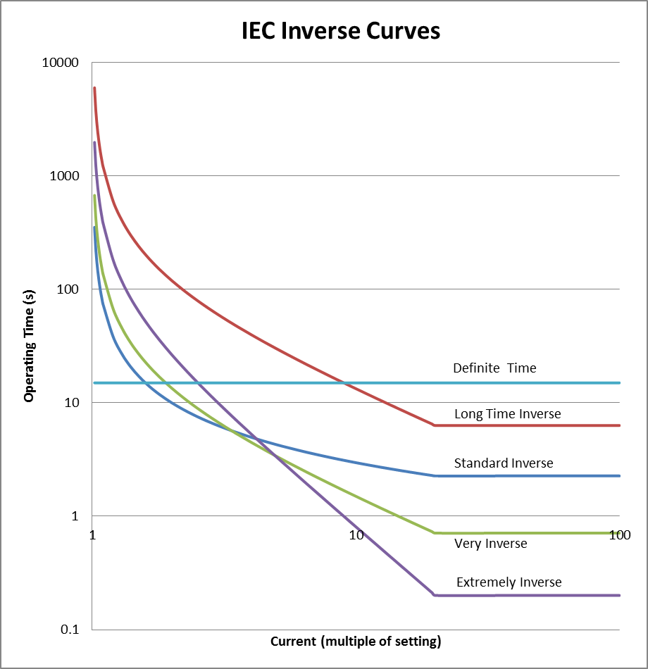
Protection
Inverse Definite Minimum Time (IDMT) Overcurrent protection
By combining current and time, it is easier to achieve grading with overcurrent relays. It is possible to apply fixed current and time settings (definite time, DT operation), however faster operation can be achieved by applying ‘inverse time’ type characteristics. (See diagram for IEC curves similar exist for IEEE.)
This type of relay operates faster for higher fault currents. With these relays a current setting and time-multiplier setting are applied to the relay.
These relays can have different shapes of inverse curve but they all have a definite minimum operating time usually at 20 or 30 times plug setting current.
Notes:
No specific notes.

Slide 42
Protection
Fuses
A fuse is a device which protects a circuit against overload by opening the circuit due to the melting of its fuse element. A fuse element is the replaceable part of the fuse designed to melt and break the circuit, normally housed in a fuselink. At lower voltages, the fuselink may be inserted into a carrier, which is fitted into a base. The larger the current through a fuse, the quicker the element melts and the current is interrupted. Fuses can operate faster than circuit breakers (~5ms),and may operate before fault current reaches its peak value thus effectively limiting fault level.
Fuses can be applied for protection of capacitors, transformers and motors, with characteristics available for particular applications (to withstand motor starting current or transformer inrush as applicable) and different types are available.
Expulsion type –usually mounted on poles in distribution circuits and consist of a tube with the fuse element inside. Operation melts the fuse element. The breakage of the element releases a spring mechanism causing the top contact of the tube to disengage and the tube falls around the lower contact/hinge point, making operation easier to spot on subsequent investigation.
Notes:
No specific notes.

Slide 43
Protection
Fuses
Current limiting type –protects equipment against fault levels which could be greater than the existing switchgear capability by operating very quickly before the current reaches its peak.
Advantages | Disadvantages
Relatively cheap. | Takes time and labour to replace and restore circuit.
Do not require maintenance like circuit breakers do. | Limited to distribution voltages (typically < 33kV)
Current limiting fuses limit short circuit current and may avoid/defer replacement of switchgear with that of a higher rating. | Expulsion fuses can operate violently due to expulsion of gases and need adequate clearances.
HRC fuse ratings can be changed within the range of the size of the fuse carrier size. | Do not provide any indication of failure other than breaking the circuit.
Variety of ratings/ characteristics available.
High rupture capacity (HRC) – often found in a cartridge style, they are able to provide rapid clearance of faults with very high fault levels (tens of kA).
Capacitor protection –series or shunt capacitor banks tend to comprise a number of individual capacitor cans and elements and internal or external fuses allow continued operation of the bank by disconnecting individual faulted capacitors.
Advantages and Dis-advantages of Fuses
Notes:
No specific notes.

Slide 44
Protection
Simple Impedance Protection
The diagram to the right shows a pure impedance relay characteristic.
If the impedance is anywhere in the shaded zone then the relay will operate.
If a relay is located on a feeder circuit and a fault occurs on another circuit from the same busbars and the impedance to the fault lies within the circle the relay will operate. This means that the relay has no direction and the zone of operation is not useful.
X
Operational
Zone
R
Pure Impedance Relay
Notes:
No specific notes.

Slide 45
Protection
Mho Protection
X
In order to give the impedance relay some directionality the Mho relay was developed. This was back in the days of electromechanical relays.
The relay has its maximum reach along the characteristic angle of the transmission line. (i.e. the diameter of the circle).
The relay will operate for any measured impedance which falls within the circle.
It should be noted that this relay cannot see any faults occurring behind the relaying point i.e. it has no reverse reach.
θ
R
= Characteristic angle of line (tan θ = X / R)
Typically 75 – 80 degrees. Note – No reverse reach
θ
Relay with Mho characteristic
Notes:
No specific notes.

Slide 46
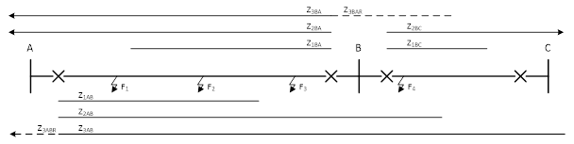
Protection
Distance Protection Zones
The first zone is set to operate instantaneously.
Ideally Zone 1 would cover the whole of the feeder but because of errors it is usually set to 75-80% of the feeder length.
The second zone trips after 0.4-0.5 seconds.
The reach of Zone 2 must be more than the first feeder.
The third zone trips after 0.8-1.0 seconds.
The reach of Zone 3 will be longer than Zone 2.
Zone 3 reverse reach (see dotted lines) also trips in the same time as forward Zone 3.
The reach of Zone 3 rev. is typically 10% of Zone 3 forward for offset Mho. (see next slide)
Notes:
The reason that Zone 1 cannot be set to 100% of the line impedance is that the current and voltage transformers will have errors and also the relay will not be 100% accurate. Even if these could be overcome the impedance of the line will not be 100% accurate and it will vary with temperature and sag.

Slide 47
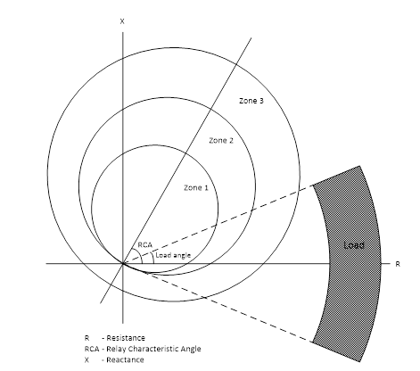
Protection
3 Zone Mho Protection
The majority of early distance protection relays were of the three zone Mho type or more strictly two Mho zones and one offset Mho zone.
Each of the circles has its diameter along the characteristic angle of the line.
For the two Mho circles the circumference passes through the origin which means that they have no reverse reach.
The offset Mho however is offset from the origin and so it has a short reverse reach.
One of the problems of the Mho characteristic is that it can encroach on load.
Notes:
Typically load will lie relatively close to the resistance axis. The higher the load current the closer the load point will move towards the origin and may then fall into the reach of one of the circles.

Slide 48
Protection
Effect of Fault Resistance on reach of Mho Protection
If there is resistance at the point of fault e.g. flashover to a tree then the resistance will be added to the impedance of the fault.
The diagram shows this condition at the limit of the reach of the relay. The resultant measured impedance will be much larger as shown and now lies outside the operating circle of the relay.
This means that the relay will under reach under these conditions.
Fault resistance
X
Measured impedance
R
Notes:
No specific notes.

Slide 49
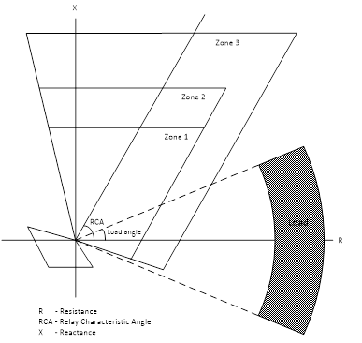
Protection
Quadrilateral Distance Protection Characteristic
The diagram to the right shows a typical distance relay quadrilateral characteristic.
It can be seen that a fixed amount of resistance can be added to the line impedance at any point along the line without the measured impedance falling outside of the operating zone.
This shape of characteristic is also better for avoiding load encroachment and so is more popular these days.
Notes:
With early electromechanical distance relays the number of different shaped characteristics was very limited. With the introduction of numerical relays a wide variety of different shaped characteristics are possible.

Slide 50
Protection
Permissive Under-reaching Transfer Trip (PUTT) Scheme
Z3R
Z3
Z2
Z1
C
A
B
F
X
X
X
X
X
X
Z1
Z2
Z3
Z3R
Fault at point F is seen in Zone 1 from end A and trips end A.
The Z1 at end A sends a permissive signal to end B.
End B sees the fault at point F in Zone 2 and on receipt of the permissive signal from end A it bypasses the Zone 2 timer and trips end B.
Notes:
This scheme is also sometimes known as an acceleration scheme because the tripping of Zone 2 is accelerated by the receipt of the permissive signal. The logic of the term PUTT is that it is the under reaching element (Zone 1) which sends the permissive transfer trip signal.

Slide 51
Protection
Permissive Over-reaching Transfer Trip (POTT) Scheme
Z3R
Z3
Z2
Z1
C
A
B
F
X
X
X
X
X
X
Z1
Z2
Z3
Z3R
Fault at point F is seen in Zone 1 from end A and trips end A.
The Z2 at end A also sees fault at point F and sends a permissive signal to end B.
End B sees the fault at point F in Zone 2 and on receipt of the permissive signal from end A it bypasses the Zone 2 timer trips end B.
Basically same as PUTT except it is the over-reaching Z2 element that sends the permissive signal.
Notes:
The operation of the Zone 2 elements is basically simply directional. The elements at each end of the line can see a fault in the direction of the line so the fault must be on the line.

Slide 52
Protection
Blocking Distance Scheme
Z3R
Z3
Z2
Z1
C
A
B
F1
F2
F3
X
X
X
X
X
X
Z1
Z2
Z3
Z3R
Fault at F1 is seen by Z1 from end A and trips.
Fault at point F2 is seen by Z2 at end A. Z2 will trip in approx. 40ms if it does not receive a blocking signal from Z3R at end B.
Fault at F2 is not seen by Z3R at end B so no blocking signal sent. End B trips after 40ms.
Fault at point F3 is seen by Z2 at end A.
Fault at point F3 is seen from end B by Z3R so blocking signal sent to end A. End A trips after Z2 time delay. (approx. 0.4-0.5 secs).
Note: Z3R at end B must reach further than Z2 from end A to ensure that blocking signal is sent.
Notes:
This is a more complicated scheme than the PUTT and POTT schemes. Instead of a permissive signal being sent a blocking signal is sent to stop the fast operation of Zone 2 at end A if the fault is detected as being beyond end B.

Slide 53
Protection
Effect of Communication Channel failure on Distance Protection Schemes
For permissive schemes, PUTT and POTT if the communication channel fails then the fast tripping for internal faults will not occur. Such schemes can be referred to as “Trip Shy” i.e. will fail to trip when they should do.
For a Blocking scheme, if the communication channel fails then the blocking signal to prevent fast tripping for an external fault will not be sent and fast tripping will occur incorrectly. Such a scheme can be referred to as “Trip Happy” i.e. likely to trip when it should not.
To avoid Blocking schemes from being “Trip Happy” they will normally be arranged to revert to plain distance if the communication channel fails. However, if the channel fails at the time of the fault then they will be “Trip Happy”
Notes:
No specific notes.

Slide 54
Protection
Differential Protection
For an external fault the current in the secondaries of the current transformers at each end of the circuit flows in the same direction.
The current circulates around the CT circuits but no current flows through the differential relay.
Hence the protection is stable and does not operate.
Notes:
No specific notes.

Slide 55
Protection
Differential Protection
For simplicity the fault current from each end has been assumed to be the same for this internal fault.
For a double fed internal fault the current in the secondaries of the current transformers at each end of the circuit flows in opposite directions.
The current circulates around the CT circuits until it reaches the differential relay when the two secondary currents add together and flow through the relay.
Hence the protection operates.
For a single end fault current only flows in the CT at the feeding end and returns through the relay.
Notes:
No specific notes.

Slide 56
Protection
High Impedance Differential Protection
Designed to remain stable if a CT saturates at maximum through fault current. Saturated CT assumed to have no useful output and replaced by secondary resistance.
Maximum through fault current (sec) then flows through lead burden and CT resistance and develops voltage V_{S.}
Relay operating voltage set to higher than V_{S} for stability.
Notes:
This is a differential protection designed to not maloperate if one of the CTs saturates. It is called high impedance because the relay circuit has high impedance and so needs a high voltage to operate it. Some times the relay has voltage settings but sometimes it is a current operated relay with a stabilizing resistor.

Slide 57
Second set of Questions

Slide 58
Protection
Biased Differential Protection principle
Consider a biased differential relay as a balanced beam relay with an operating winding acting on one side of the beam and a stabilising winding acting on the other.
For an external fault i₂ and i₁ both flow in the stabilising winding in the same direction.
The current through the operating winding is only i₂ minus i_{1.} So beam tips towards stabilising side and relay does not operate.
Notes:
No specific notes.

Slide 59
Protection
Biased Differential Protection principle
For an internal fault i₂ and i₁ flow through the stabilising winding in opposite directions so largely cancelling out the pull of the stabilising winding.
The current through the operating winding is i₂ plus i_{1.} So beam tips towards operating side and relay operates.
For single end faults the same current flows through the operating winding and only one half of the stabilising winding so beam tips towards operate side and relay operates.
Notes:
No specific notes.

Slide 60
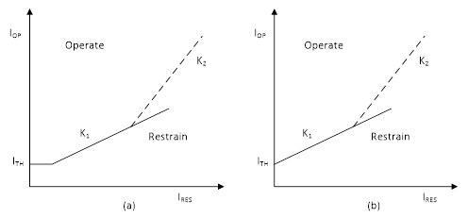
Protection
Biased Differential Protection
Typical bias characteristics are shown in the diagrams to the right.
Modern biased differential relays are digital.
The bias current principle allows an initial low threshold operating or bias setting (ITH), making the relay sensitive, whilst at higher currents the bias setting is higher, making it less likely to maloperate.
Biased differential protection is commonly used on two winding transformers with tap-changers and also for line, busbar and generator protection.
Examples of bias Characteristics
Notes:
No specific notes.

Slide 61
Protection
Tripping Philosophies
1 out of 2 tripping. This is where there are two protections, say first and second main, then operation of either protection will initiate tripping of the circuit. This allows for one of the protections to have failed.
2 out of 2 tripping . This is used where operation may cause tripping of a number of circuits, then a more secure method is used so that both protections must operate to initiate tripping. Example of this is busbar protection.
2 out of 3 tripping. This is used on very important circuits. This requires two out of three protections to operate to cause tripping. This has the advantage that maloperation of one relay will not cause unnecessary tripping, but failure of one protection will not prevent tripping.
Notes:
No specific notes.

Slide 62
Protection
Tripping Philosophies
Transfer tripping is used to also trip a circuit breaker at a remote location via a communication channel. This may be either direct or permissive.
Direct Transfer trip – this means that upon receipt of the signal the circuit breaker will be tripped without reference to any other device. This is often used from busbar protection to trip the remote ends of circuits which have a unique circuit breaker.
Permissive Transfer trip – this is where the transfer trip will only cause tripping at the remote end after it has been qualified by another condition. Examples of this are PUTT and POTT discussed earlier for distance protection.
However, sometimes the condition is applied before the signal is sent. For example from busbar protection on a teed feeder where tripping of the remote ends would lose the interconnection unnecessarily. In this case the signal may be qualified by CB fail protection.
Notes:
No specific notes.

Slide 63
Protection
Importance of Correct Relay Settings
As well as selecting the correct type of protection for a circuit it is important that the correct relay settings are applied to ensure correct operation when required and no operation when not required. These should be regularly reviewed to ensure applicability in case of system changes.
Most Utilities will have their own clearly set out policy for protection settings defining relay reach and time settings etc.
With modern numerical relays there are a large number of choices of settings and also multiple setting groups. In addition to the operational settings there are also configuration settings within the relay which must be set correctly. Managing these numerous settings can pose a problem for Utilities and they need to have a system for managing these.
A careful check should be made to ensure that any unwanted settings have been disabled, or if that is not possible they have been set to the maximum value to avoid unwanted tripping.
Notes:
No specific notes.

Slide 64
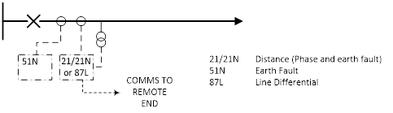
Protection
Typical Feeder Protections
Typical Basic Protection for Sub-transmission Feeder
This shows a feeder with one main protection and backup earth fault protection.
The main protection may be distance or differential. Distance protection inherently provides some back up protection.
If differential protection is used for the main protection the back up may also use overcurrent as well as earth fault for the back up protection.
Notes:
This may be used for 132KV lines.

Slide 65
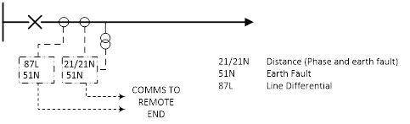
Protection
Typical Feeder Protections
Typical Basic Protection for Transmission Feeder
This shows a feeder with two main protections and two backup earth fault protections.
The first main protection is differential and the second main protection is distance. Distance protection inherently provides some back up protection.
Notes:
No specific notes.

Slide 66
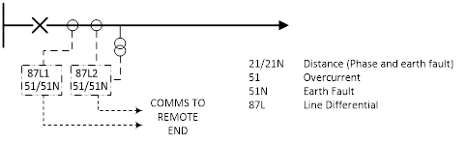
Protection
Typical Feeder Protections
Typical Basic Protection for a Short Transmission Feeder
When the feeder is very short, distance protection is not suitable.
In this case there are two main protections which are both differential protections.
Because these do not provide any back up protection there are two overcurrent and earth fault back up protections.
Notes:
No specific notes.

Slide 67
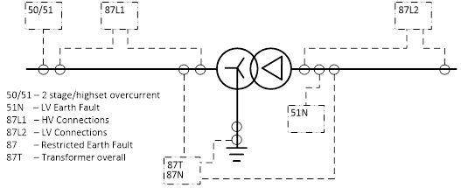
Protection
Typical Transformer Protections
N
Diagram shows transformer with HV and LV connections protection, 2 stage and highset HV overcurrent, LV earth fault, HV restricted earth fault and transformer overall protection.
The transformer overall protection will normally be biased differential protection with load bias and second harmonic bias for inrush current.
Notes:
This is typical for a double wound transformer.

Slide 68
Protection
Alternative Autotransformer Protection
The overall protection for an autotransformer may also use a biased differential protection.
However, the diagram to the right shows a pure circulating current protection for 1 phase of an autotransformer.
It should be noted that a neutral current transformer is fitted at the neutral end of each phase, not a common neutral CT.
The CTs at all three locations have the same ratio and the current works purely on Kirchoff’s law that what goes in comes out.
It therefore does not require any biasing for load or inrush currents.
Diagram for 1 phase of auto-transformer
Notes:
No specific notes.

Slide 69
Protection
Summary of Transformer/Autotransformer Protections
Here is a summary of the protections usually fitted to a transformer or autotransformer. This includes the mechanical protections in addition to the electrical ones.
Differential Protection – biased or circulating current dependent on type of transformer
Restricted earth fault protection
2 stage overcurrent protection
High set overcurrent protection
Buchholz – (gas operated relay)
Winding temperature
Oil temperature
Pressure relief protection
In some geographic locations, subject to high sunspot and other solar activity, there may be a need for an additional protection to detect geomagnetically induced currents and remove the transformers to avoid damage from winding and tank overheating.
Notes:
2 stage overcurrent trips the LV CB first and if that clears the fault the HV CB remains closed. If after tripping the LV CB the fault current is still flowing then the HV CB is tripped after the second stage time delay.

Slide 70
Protection
Typical Reactor Protection
Shunt reactor protection with phase by phase overall protection.
Restricted earth fault protection
Three phase overcurrent protection
Mechanical protections similar to transformers
Series reactor protection with phase by phase overall protection
Three phase overcurrent protection
Mechanical protections similar to transformers
Notes:
No specific notes.

Slide 71
Protection
Busbar Protection
The diagram to the right shows a typical bus zone scheme for a single busbar with two sections using biased or high impedance differential protection.
In order for tripping to occur operation of the check relay and one of the discriminating relays Z1 or Z2 is required.
In simple terms the check relay identifies that there is a fault somewhere at the substation and the discriminating relays identify which section of bar is faulted.
Notes:
No specific notes.

Slide 72
Protection
Busbar Protection
In recent years with the rapid spread of numerical relays modern low impedance busbar protection schemes have been developed. These schemes may be distributed or centralized but usually consist of a Central unit and a field unit per bay. These schemes have several advantages as follows:-
Connected by fibre-optics so fewer cross site connections.
Fully self supervised.
Low CT Requirement – CT saturation detector.
CT ratio correction (can use CTs with different ratios).
CT’s can be shared with other protections.
No CT switching required.
Notes:
It should be noted that some Utilities pay for the expensive numerical busbar protection but still use dedicated and expensive CTs.

Slide 73
Protection
Busbar Protection
This shows a busbar protection scheme for a double busbar substation with a wraparound main bar.
The protection has a check zone, two main busbar zones and a reserve busbar zone which can be split into two zones if the section disconnector/s is open.
Notes:
No specific notes.

Slide 74
Protection
Busbar Protection
Basic architecture for numerical busbar protection.
Field Units
Central Unit
Notes:
The connections from the field units to the central unit will normally be by fibre optics.

Slide 75
Protection
Busbar Protection
Field Unit
CTs permanently connected.
Simple tripping conection.
Monitor switches via double pole indication.
Often contain other protection functions.
  Central Unit
  Performs all zone differential calculations.
  Multiple algorithms.
  Creates bus zone replica from switch positions.
  Sends trip command to correct bay units.
Notes:
No specific notes.

Slide 76
Protection
Circuit Breaker Fail Protection
  If a CB Fails to trip need to trip other CBs that are feeding fault
  Trip all breakers on same busbar
  Convenient to use busbar protection tripping buswires
  Numerical BB Protection has CB Fail built in as a function
Notes:
If the fault was a busbar fault then need to trip the CB at the other end of the circuit.

Slide 77
Protection
Circuit Breaker Fail Protection
CB Fail overcurrent is started by any protection which requests the CB to trip.
When the overcurrent is picked up the timer starts to run.
If CB trips the overcurrent resets and the timer stops timing.
If the CB does not trip the overcurrent remains picked up and the timer continues to run.
When the preset time is reached the timer contact closes and initiates tripping of the associated busbar and the remote end of the feeder.
Notes:
No specific notes.

Slide 78
Metering and Monitoring
Accuracy Classes
Instruments are classified by the following accuracy classes in IEC. (ANSI has similar but different classes).
0.05-0.1-0.2-0.5-1.0-1.5–2.0-2.5-5
The accuracy is expressed as one hundred times the quotient of the absolute error and the upper limit of the effective range (Total Scale Length). The absolute error being the difference obtained by subtracting the true value of the quantity from its measured value.
Typical accuracy classes for measuring equipment would be:
Amps 1.0 Volts 1.0 Watts 1.5 Vars 1.5 Frequency 0.5 Phase Angle 2.5 Power Factor 2.5 kWatthour 2.0 kVarhour 2.0
However when the kWatthour or kVarhour meters are being used for tariff purposes at a point of sale then the accuracy class will normally be 0.2S.
Notes:
No specific notes.

Slide 79
Metering and Monitoring
Tariff Metering
Two sets of meters will normally be used, a main set and a check set.
The main set of meters will normally be connected to CT cores and VT windings also with accuracy class of 0.2S and dedicated solely to the supply of the meters.
The check meters will also require CT cores and VT windings with accuracy class 0.2S but in this case other equipment may be connected to the same cores and windings. though the burden imposed by the other equipment may affect, and need to be taken into account when calibrating and commissioning the meters.
Notes:
No specific notes.

Slide 80
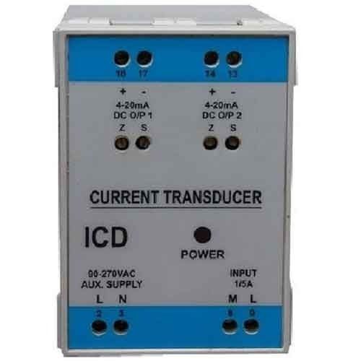
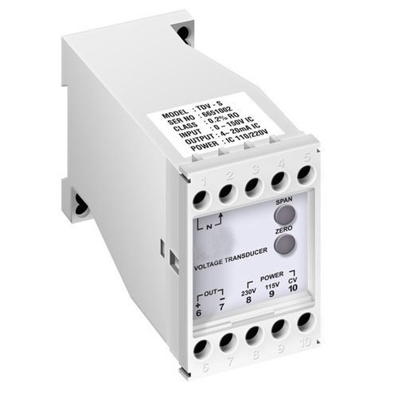
Metering and Monitoring
Transducers
The output of a transducer is normally a DC analogue current signal which is proportional to the input quantity to be measured.
The input quantity may be current, voltage or power.
They can be used in conjunction with instruments and recorders, and are convenient for local and remote indication.
They present a low burden on current and voltage transformers.
Although some SCADA systems can take CT and VT inputs directly some SCADA systems may require the use of suitable transducers.
Digital transducers are now available which measure an analogue input, such as current, and convert it into a digital voltage output.
These can be interfaced directly to a microprocessor controlled system without the need for any supplementary signal conditioning equipment and have a much better immunity to electrical noise and electromagnetic interference.
Notes:
No specific notes.

Slide 81
Metering and Monitoring
Fault Locators
When a persistent fault occurs on an overhead line then a line gang has to be dispatched to find the fault and repair it. A fault locator is a device intended to identify the fault location to within two or three spans.
Many methods have been used in the past but for AC lines the majority of fault locators use some form of impedance measurement. Initially the fault locator would be a standalone device but with the development of numerical relays it is possible to have the fault location algorithm built into a protection relay.
However, impedance measurement is not suitable for HVDC lines and so methods using travelling waves have been developed for use on such lines and these may also be used on very long AC transmission lines.
Notes:
No specific notes.

Slide 82
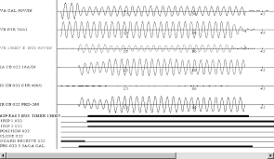
Metering and Monitoring
Fault Recorders
Fault recorders allow us to record analogue signals of currents and voltages immediately preceding, during and after a fault which can be extremely useful in analysing fault events.
Normally the fault recorder will present approximately 250ms of pre-fault information. In addition to the analogue channels it is possible to have digital channels indicating operation of specific relays or other indicators.
Originally, fault recorders were standalone devices but with modern numerical relays the fault recorder function can easily be built into a relay.
The triggering of the fault recorder function can be by a level setting in the analogue channels such as current exceeding a certain amount or voltage falling below a predefined value or by operation of certain digital initiations.
Notes:
No specific notes.

Slide 83
Metering and Monitoring
Sequence of Events Recorders
When system faults occur it can be very advantageous to have accurately timed information of such items as the operation of circuit breakers or other items of primary plant as well as the operation times of protection relays, auto reclose actions and alarms.
This information is gathered by a sequence of events recorder (SER), which is a standard function within substation control systems.
The accuracy of the time stamping of the information should be within 1ms and ideally synchronised accurately across different sites. This is particularly important when a system fault affecting a number of sites needs to be studied.
The time source will normally be from a GPS clock and different methods are available for synchronising between devices on a site. The detail of these methods such as IRIG-B and IEEE 1588 are outside of the scope of this course.
Notes:
No specific notes.

Slide 84
Metering and Monitoring
Supervision
As the majority of secondary equipment may not operate for very long periods of time, but then be required to operate within milliseconds to clear a fault it is very important to know that the dormant equipment is healthy. In order to do this supervision equipment is provided.
With modern numerical relays self supervision is built into the relays.
The computer control system, which is also self supervised, will generally annunciate any unusual conditions as alarms.
One particular type of supervision is trip circuit supervision for circuit breakers and this is described in the next slide.
Notes:
No specific notes.

Slide 85
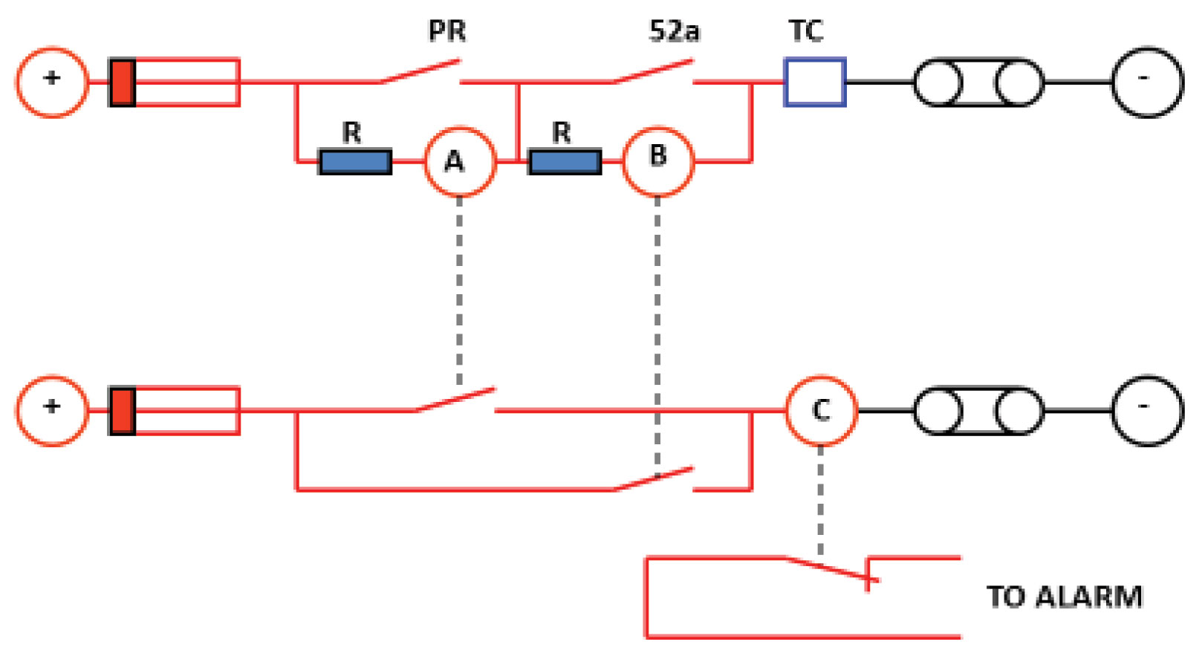
Metering and Monitoring
Trip Circuit Supervision
It is important to know that if a fault occurs the trip circuit of the circuit breaker is healthy.
Trip circuit supervision monitors that the supply voltage to the trip circuit is healthy and also checks the continuity of the complete trip circuit.
In the circuit opposite this is effective for both the condition when the circuit breaker is closed and also when the circuit breaker is open. i.e. before closing the circuit and putting it into service.
PR - Protection relay contact.
TC – Circuit breaker trip coil.
52a – Normally open contact of circuit breaker.
R – resistors.
A – relay monitoring when circuit breaker is closed.
B – relay monitoring when circuit breaker is open.
C – relay energized when circuit is healthy with normally closed contact to give alarm when system is faulty.
Notes:
No specific notes.

Slide 86
Final Questions

